Slide 1
GTBANK CUSTOMER
CHURN ANALYSIS
Retention risks, customer behaviour and practical priorities
Analysis of 10,000 customer records
Notes:
[Sources]
- User-provided workbook: Customer Churn (GT Bank) COMPLETE skill PROJECT 3(1).xlsx
[/Sources]

Slide 2
GTBANK CUSTOMER CHURN ANALYSIS
One in five customers has left the bank
10,000
2,037
20.37%
TOTAL CUSTOMERS
CHURNED CUSTOMERS
CHURN RATE
Complete customer records analysed
Customers recorded as Exited = 1
Overall proportion that left
51.51%
₦ 764,858,8
ACTIVE MEMBERSHIP RATE
TOTAL ACCOUNT BALANCE
Customer classified as active members
Customer Combined account balance
Of the 10,000 customers analysed, 2,037 have left the bank, producing a churn rate of 20.37%. Although 55.15% are active members, losing approximately one in every five customers indicates a significant retention challenge. With a combined account balance of ₦764.86 million, improving customer retention could help protect deposits and strengthen long-term relationships
02
Notes:
[Sources]
- User-provided workbook: Customer Churn (GT Bank) COMPLETE skill PROJECT 3(1).xlsx
[/Sources]

Slide 3
GTBANK CUSTOMER CHURN ANALYSIS
Clean, grouped data makes the churn patterns comparable
What was prepared
How calculations were checked
• Removed personal surnames from the analysis view
Category labels were standardised, numeric fields were checked for valid ranges and churn percentages were calculated as churned customers divided by customers in each group. The total was reconciled to 7,963 retained and 2,037 exited customers.
• Checked Customer ID and row counts for 10,000 records
• Converted Exited into retained and churned outcomes
• Grouped age, tenure, balance and product ownership
Final validation: 7,963 retained + 2,037 churned = 10,000
Grouping continuous fields makes the patterns easier to communicate, while retaining the original numeric columns means averages and detailed investigation remain possible.
03
Notes:
[Sources]
- User-provided workbook: Customer Churn (GT Bank) COMPLETE skill PROJECT 3(1).xlsx
[/Sources]

Slide 4
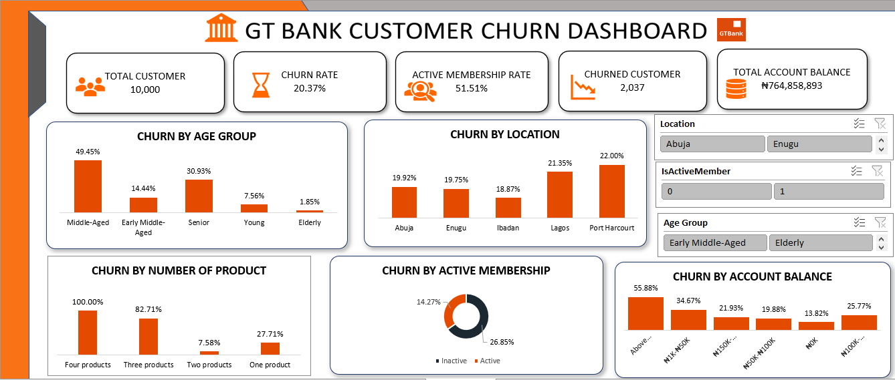
EXECUTIVE DASHBOARD

Slide 5
GTBANK CUSTOMER CHURN ANALYSIS
2,037 customers exited during the period
20.37%
overall customer churn
Approximately one customer left for every four customers retained.
The headline churn rate provides the baseline for every other comparison. Groups substantially above 20.37% deserve priority attention, while groups below it can help reveal behaviours linked with stronger retention.
05
Notes:
[Sources]
- User-provided workbook: Customer Churn (GT Bank) COMPLETE skill PROJECT 3(1).xlsx
[/Sources]

Slide 6
GTBANK CUSTOMER CHURN ANALYSIS
Middle-aged customers show the highest age-based churn
Middle-aged customers churn at 49.45%, more than six times the 7.56% rate among young customers. The pattern suggests that life-stage needs, service expectations or product relevance may change sharply as customers age.
06
Notes:
[Sources]
- User-provided workbook: Customer Churn (GT Bank) COMPLETE skill PROJECT 3(1).xlsx
[/Sources]

Slide 7
GTBANK CUSTOMER CHURN ANALYSIS
Female customers record a much higher churn rate
Female churn is 25.07% compared with 16.46% for male customers—an 8.61 percentage-point gap. The difference should prompt deeper investigation into product use and service experience rather than assumptions based on gender alone.
07
Notes:
[Sources]
- User-provided workbook: Customer Churn (GT Bank) COMPLETE skill PROJECT 3(1).xlsx
[/Sources]

Slide 8
GTBANK CUSTOMER CHURN ANALYSIS
Inactive customers are almost twice as likely to leave
Inactive members record a 26.85% churn rate, compared with 14.27% for active members. This 12.58-point difference makes declining activity one of the strongest practical early-warning indicators in the dataset.
08
Notes:
[Sources]
- User-provided workbook: Customer Churn (GT Bank) COMPLETE skill PROJECT 3(1).xlsx
[/Sources]

Slide 9
GTBANK CUSTOMER CHURN ANALYSIS
Product ownership reveals both loyalty and overload
Two-product customers are the most stable at 7.58%, while churn rises to 82.71% for three products and 100% for four. The four-product group contains only 60 customers, but the extreme result still suggests product complexity, suitability or servicing problems.
09
Notes:
[Sources]
- User-provided workbook: Customer Churn (GT Bank) COMPLETE skill PROJECT 3(1).xlsx
[/Sources]

Slide 10
GTBANK CUSTOMER CHURN ANALYSIS
Churn increases in several higher-balance groups
Zero-balance customers have the lowest churn at 13.82%, while the very small above-₦200K group reaches 55.88%. Because the highest band contains only 34 customers, the bank should prioritise individual review of these valuable accounts rather than generalise from the rate alone.
10
Notes:
[Sources]
- User-provided workbook: Customer Churn (GT Bank) COMPLETE skill PROJECT 3(1).xlsx
[/Sources]

Slide 11
GTBANK CUSTOMER CHURN ANALYSIS
Port Harcourt and Lagos record the highest location rates
Location differences are modest: Port Harcourt reaches 22.00% and Ibadan 18.87%, a spread of only 3.13 points. Geography matters less than age, activity or product ownership, so branch-level action should follow deeper customer-level analysis.
11
Notes:
[Sources]
- User-provided workbook: Customer Churn (GT Bank) COMPLETE skill PROJECT 3(1).xlsx
[/Sources]

Slide 12
GTBANK CUSTOMER CHURN ANALYSIS
Customer tenure has only a limited relationship with churn
Churn ranges narrowly from 18.87% to 21.30% across tenure groups. Long service alone does not guarantee retention, and the bank should avoid relying on tenure without also considering activity, age and product experience.
12
Notes:
[Sources]
- User-provided workbook: Customer Churn (GT Bank) COMPLETE skill PROJECT 3(1).xlsx
[/Sources]

Slide 13
GTBANK CUSTOMER CHURN ANALYSIS
Credit-card ownership barely changes the churn rate
Customers with cards churn at 20.18% compared with 20.81% among customers without cards—a difference of only 0.63 points. Card ownership is therefore a weak retention indicator in this dataset.
13
Notes:
[Sources]
- User-provided workbook: Customer Churn (GT Bank) COMPLETE skill PROJECT 3(1).xlsx
[/Sources]

Slide 14
GTBANK CUSTOMER CHURN ANALYSIS
New customers churn slightly more than long-term customers
New customers record 21.15% churn, compared with 19.67% among long-term customers. The improvement is small, showing that onboarding matters but does not explain the major churn differences found elsewhere.
14
Notes:
[Sources]
- User-provided workbook: Customer Churn (GT Bank) COMPLETE skill PROJECT 3(1).xlsx
[/Sources]

Slide 15
GTBANK CUSTOMER CHURN ANALYSIS
Age, inactivity and product strain define the highest risk
The combined comparison makes the priorities clear: product overload and middle age are the largest rate gaps, followed by inactivity, one-product ownership and female churn. These factors should guide customer review, but multivariable analysis is needed to identify overlapping effects.
15

Slide 16
INSIGHT
Seven findings define the retention challenge
1. Overall churn is 20.37%, representing 2,037 customers.
5. Three- and four-product customers show extreme churn.
2. Middle-aged customers reach a 49.45% churn rate.
6. Female churn exceeds male churn by 8.61 percentage points.
3. Inactive members churn almost twice as often as active members.
7. Location, tenure and credit-card differences are comparatively weak.
4. Two products are linked with the strongest retention.
16
Notes:
[Sources]
- User-provided workbook: Customer Churn (GT Bank) COMPLETE skill PROJECT 3(1).xlsx
[/Sources]

Slide 17
RECOMMENDATION
Act first on engagement and high-risk customer groups
01
Create inactivity alerts
Trigger outreach when transactions or digital activity decline over a defined period.
02
Review product-heavy accounts
Contact three- and four-product customers to check suitability, fees and service problems.
03
Build life-stage retention
Design tailored reviews for middle-aged and senior customers before renewal or attrition.
04
Investigate the gender gap
Compare complaints, channel use, product mix and service outcomes for women and men.
The bank should focus retention resources where rate differences are largest. Activity monitoring offers the most immediate operational trigger, while product-heavy and middle-aged groups require more detailed account review.
17
Notes:
[Sources]
- User-provided workbook: Customer Churn (GT Bank) COMPLETE skill PROJECT 3(1).xlsx
[/Sources]

Slide 18
NEXT STEPS
Build retention around early intervention and customer value
05
Strengthen onboarding
Use the first two years to establish regular product use and clear service support.
06
Protect valuable balances
Create proactive reviews for customers in high-balance bands before warning signs intensify.
07
Develop a churn model
Combine age, activity, products, balance and gender to estimate individual risk.
08
Measure saved relationships
Track customers contacted, retained balance, complaints resolved and churn avoided.
Bottom line: detect disengagement early and intervene before valuable relationships are lost.
18
Notes:
[Sources]
- User-provided workbook: Customer Churn (GT Bank) COMPLETE skill PROJECT 3(1).xlsx
[/Sources]

